Slide 1
Practice Lab:
This Practice Lab is dependent on Discussion Unit 7578/7579, and others, where most of the objects we create in this lab were introduced.
In this Practice Lab, we use another REPL; Spark/SQL is available from "dse spark-sql"
Because Scala is too hard ?!
DSE Analytics, Spark/SQL
Notes:
The goal of this Practice Lab is to:
We use the Spark SQL REPL to run some of the earlier DSE Analytics statements we detailed

Slide 2
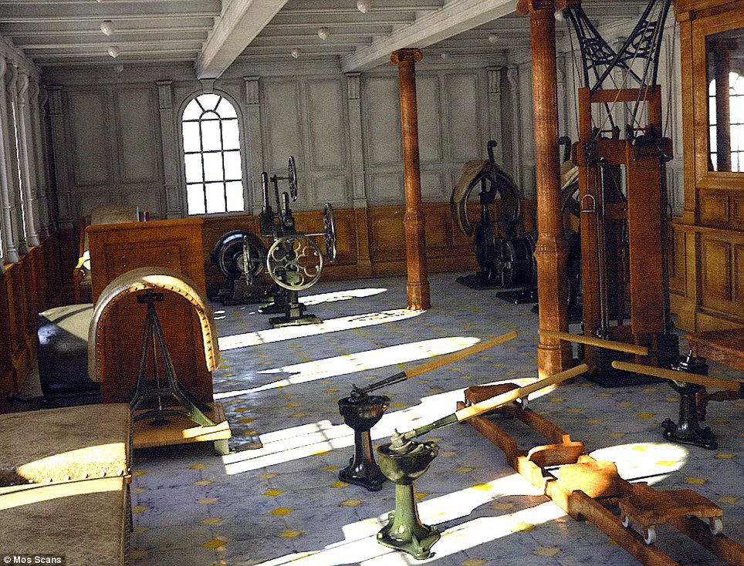
Challenge 1: Prerequisites
Prerequisites:
Instructions are provided for Linux
We will operate below recommended settings; 1 OS node only, minimum 8 GB RAM, 12 GB RAM preferred
That you have an operating single node DSE Core cluster with DSE Analytics enabled.
All work done as ‘root’
Notes:
To complete this Practice Lab, the following is assumed:
All prerequisites and conditions as listed above.
All work is expected to be executed on one OS node (instructions are written for Linux).
Because of resource constraints, it is expected you are running a single DSE Core node (no Graph, yes Analytics/Spark, no Search) on this single OS node.

Slide 3
Challenge 1: Spark SQL REPL
From the command line:
(Exist all other REPL shells)
dse spark-sql
select * from ks_7579.customer;
exit;
Run more from prior Spark/SQL Practice Labs.
Notes:
Relative to this challenge:
Exist any prior/existing Spark REPLs.
From the Linux command line, enter, dse spark-sqk
In the Spark SQL REPL enter the commands shown. ks_7579.customer is a CQL table with data, created in an earlier Practice Lab.

Slide 4

Working Goal:
From: Maury_Atwater
To: DSE_HOTSHOT
Subject: Need this now !!!
Big deal. I don't know what you've been doing ! ☹
Take my SQL/DML file with (n) statements, run those using the Spark/SQL REPL. Changes may be required to the DML.
-MA
Maury Atwater, President of Atwater's
Notes:
The email above, lists our working goal.

Slide 5

Challenge 2 (Optional): Port Maury's SQL/DML
Take the supplied SQL/DML file and run using the spark/SQL REPL. (And/or these commands are on the Notes page.)
Get each to run. changes may be required.
Notes:
Relative to this challenge: SQL/DML source statements,
----Cut File Here--------------------------------------------
DDL in effect; relevant tables only, for reference
----------------------------------------------
create table customer
(
customer_num integer not null,
fname char(15),
lname char(15),
company char(20),
address1 char(20),
address2 char(20),
city char(15),
state char(2),
zipcode char(5),
phone char(18),
//
primary key (customer_num)
);
create table orders
(
order_num integer not null,
order_date text,
customer_num integer not null,
ship_instruct char(40),
backlog char(1),
po_num char(10),
ship_date text,
ship_weight decimal(8,2),
ship_charge decimal(6),
paid_date text,
//
primary key (order_num),
foreign key (customer_num) references customer (customer_num)
);
create table items
(
item_num smallint,
order_num integer,
stock_num smallint not null,
manu_code char(3) not null,
quantity smallint,
total_price decimal(8),
//
primary key (item_num, order_num),
foreign key (order_num) references orders (order_num),
foreign key (stock_num, manu_code) references stock (stock_num, manu_code)
);
To be run using Spark SQL
----------------------------------------------
SELECT
MAX (ship_charge),
MIN (ship_charge)
FROM orders;
SELECT
o.order_num,
SUM (i.total_price) price,
paid_date - order_date span
FROM
orders o,
items i
WHERE
o.order_date > '01/01/89'
AND
o.customer_num > 110
AND
o.order_num = i.order_num
GROUP BY 1, 3
HAVING COUNT (*) < 5
ORDER BY 3;
SELECT
order_num,
count(*) number,
AVG (total_price) average
FROM items
GROUP BY order_num
HAVING count(*) > 2;
SELECT
c.customer_num,
c.lname,
o.order_num,
i.stock_num,
i.manu_code,
i.quantity
FROM
customer c,
OUTER (orders o, items i)
WHERE
c.customer_num = o.customer_num
AND
o.order_num = i.order_num
AND
manu_code IN ('KAR', 'SHM')
ORDER BY lname;

Slide 6

Practice Lab:
Lessons Learned
Notes:
Discuss what worked well, poorly, from the Practice Lab.

Slide 7
End of Unit:
Notes:
End of Practice Lab-

